Slide 1
Department of Computer Science and Engineering Academic Year 2023-2024
FACIAL EMOTION DETECTION
USING AI AND ML
KAVYASHREE K N
MEGHANA B M
PAVITHRA K

Slide 2

AGENDA:
Project Initiation
Literature Review and Requirement Analysis
Data Collection and Preprocessing
Model Development
Model Evaluation and Tuning
Implementation and Integration
Results and Analysis
Documentation and Reporting

Slide 3
FACIAL EMOTION DETECTION USING AI AND ML
INTRODUCTION:
The detection of human emotions through facial expressions is a vital aspect of many applications in human-computer interaction, behavioral analysis, and psychological studies.
This project integrates deep-face, a deep learning-based facial analysis library, with OpenCV to create a practical and efficient system for real-time facial emotion recognition. The system captures video input, processes it to detect faces, and uses pretrained models to predict and display the emotions on the video feed .

Slide 4

PROBLEM STATEMENT
“Enhancing face recognition technology to improve accuracy, reduce biases, and ensure privacy while handling diverse real-world scenarios remains a critical challenge.”
Make sure the system can identify people from various angles.
Develop the system to work for people of all backgrounds.
Keep the system easy to use and understand.
Make sure people's private information is kept safe.
Design the system to be reliable in everyday situations.

Slide 5
OBJECTIVES:
Provide a minimalistic approach to facial emotion detection. Ensure real-time emotion recognition from a webcam video feed.
Use deep-face and OpenCV technologies for accurate emotion detection.
Design the system for user-friendliness and efficiency.
Make the system suitable for immediate deployment in various applications.

Slide 6
LITERATURE SURVEY
TITLE | AUTHORS AND YEAR OF PUBLICATION | KEY POINTS | ADVANTAGE | DISADVANTAGE
Facial emotion recognition methods, datasets, and technologies: A literature survey | P. Naga, Swamy Das Marri, and R. Borreo (2023) | Advancements in Technology, Dataset Diversity, Methodological Overview, Future Directions, Evaluation Metrics | Improved Accuracy, Real-time Analysis, Context-Awareness, Compound Emotion Detection | Challenges in real-time recognition in uncontrolled environments. Limitations of current datasets. Need for specialized hardware for real-time processing.
Facial Emotion Recognition using Neighborhood Features | Abdulaziz Salamah Aljaloud, Habib Ullah, Adwan Alownie Alanazi (2020) | Utilizes Haar feature-based cascade classifiers to detect faces efficiently. | High Accuracy,Can be used in healthcare for diagnosing purpose | The method might still face challenges with varying illumination and orientations. Potential computational complexity in real-time applications.
An Emotion Recognition Model Based on Facial Recognition in Virtual Learning Environment | D. Yang, Abeer Alsadoona, P.W.C. Prasad, A. K. Singh, A. Elchouemi (2018) | Facial emotion recognition involves stages such as acquisition, feature extraction, and emotion classification | Real-time emotion detection allows teachers to adjust their strategies and improving teaching quality | The balance between accuracy and computation time was highlighted as a challenge.
Automatic recognition of student emotions from facial expressions during a lecture | Güray Tonguç and Betul Ozaydın Ozkara,(2020) | Extracting facial features using techniques such as landmark identification and distance measurements. | Adaptability,Robustness | The paper does not explicitly list drawbacks but limitations could include the sample size and potential biases in emotion recognition software.

Slide 7
METHODOLOGY
Data Preprocessing
Grayscale Conversion: Convert images to grayscale to reduce computational complexity.
Histogram Equalization: Enhance image contrast for better feature extraction.
Normalization: Scale pixel values to a range (e.g., 0-1) to standardize input data.
Model Selection
Baseline Models: Start with simple models like logistic regression or SVM for initial experiments.
Advanced Models: Implement Convolutional Neural Networks (CNNs) for better performance.

Slide 8
Model Architecture
Input Layer: 48x48 grayscale image.
Convolutional Layers: Multiple layers with ReLU activation and pooling layers to extract features.
Fully Connected Layers: Dense layers for classification.
Output Layer: Soft max layer for emotion classification.
Training
Loss Function: Cross-entropy loss for classification.
Optimizer: Adam or SGD with an appropriate learning rate.
Batch Size: Experiment with different batch sizes (e.g., 32, 64).
Epochs: Train for a sufficient number of epochs (e.g., 50-100) with early
stopping based on validation loss.

Slide 9
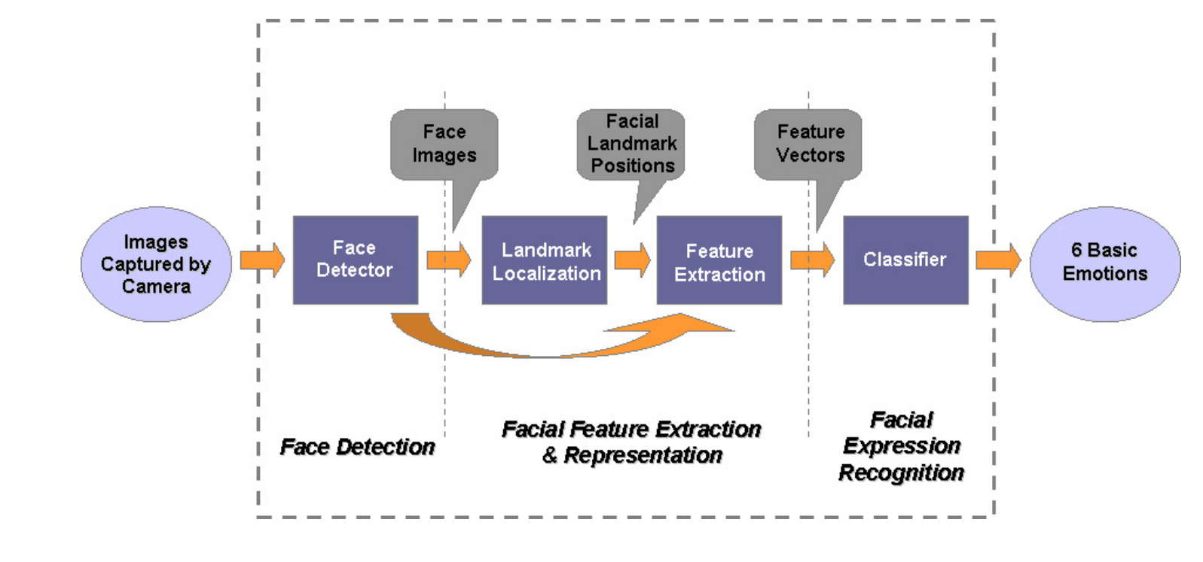
BLOCK DIAGRAM

Slide 10
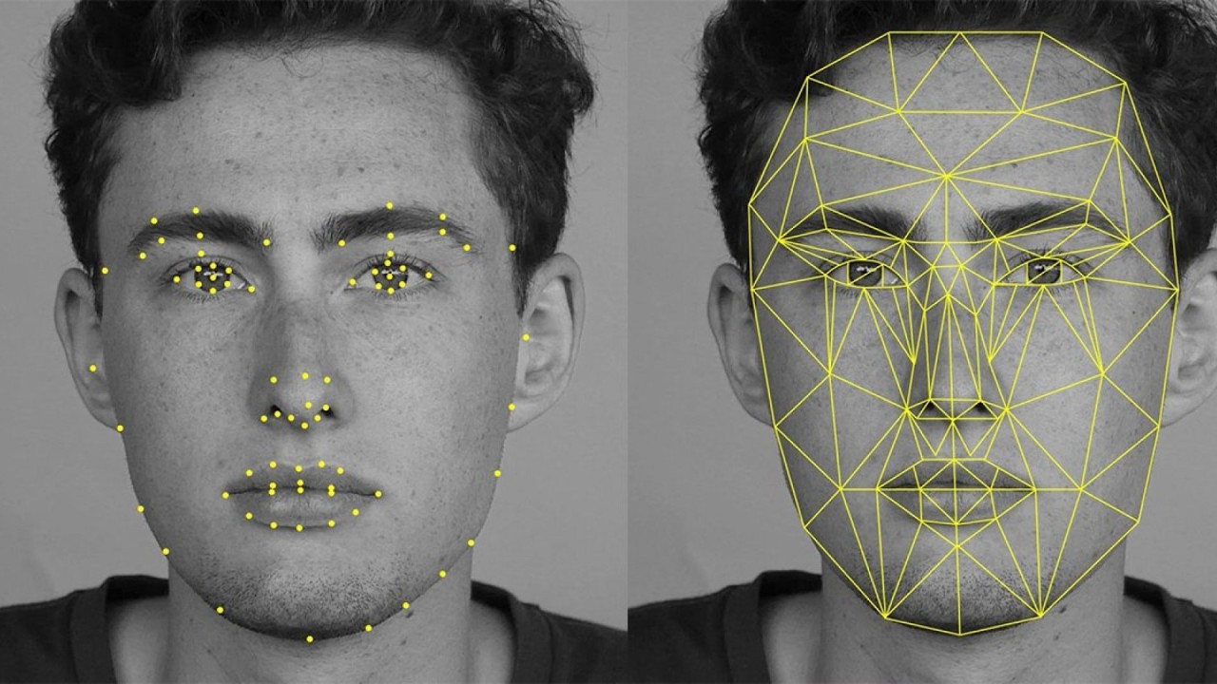
Implementation
Define Objectives and Data Collection:
Identify target emotions and gather a diverse, labeled dataset of facial expressions.
Data Preprocessing and Feature Extraction:
Detect and normalize faces, apply data augmentation, and extract features using techniques like CNNs.
Model Training and Evaluation:
Choose and train a suitable model, then evaluate its performance using metrics like accuracy and F1-score.

Slide 11
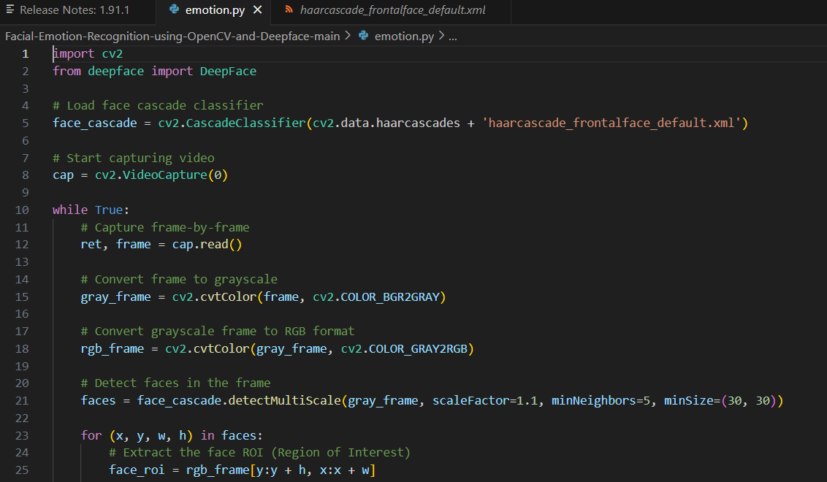

Slide 12
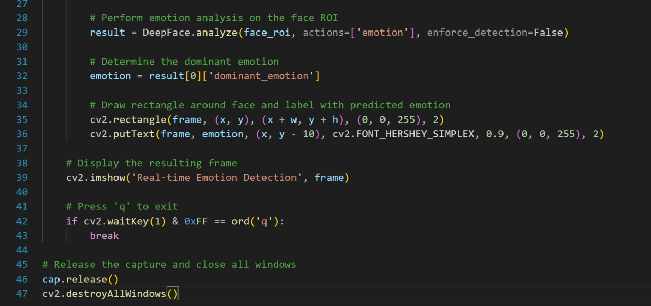

Slide 13
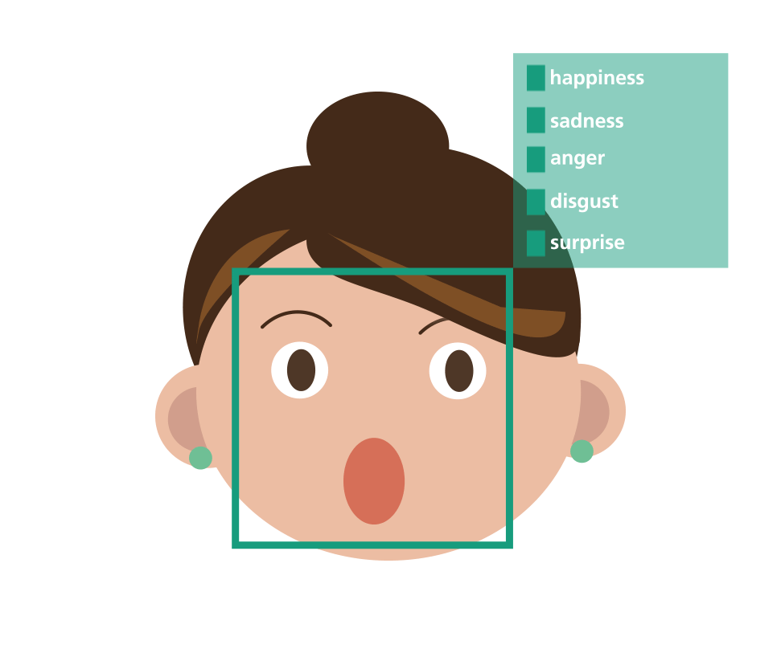
Results and Discussion
The emotion detection system achieved high accuracy, especially for emotions like happiness and surprise, due to effective deep learning models.
However, emotions like fear and disgust were more challenging to classify accurately.
Data augmentation techniques improved model robustness, and real-time deployment showed practical applicability.
Challenges included imbalanced data and subtle expressions, highlighting areas for further refinement.
Future work will focus on enhancing the dataset, exploring advanced models, and ensuring ethical use.

Slide 14
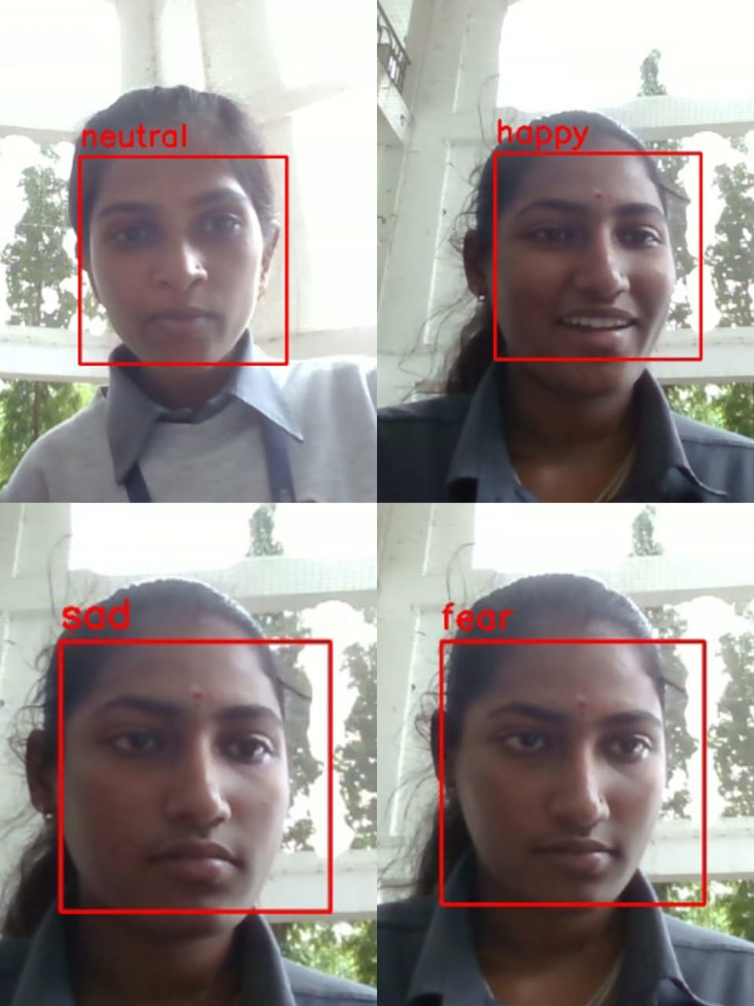
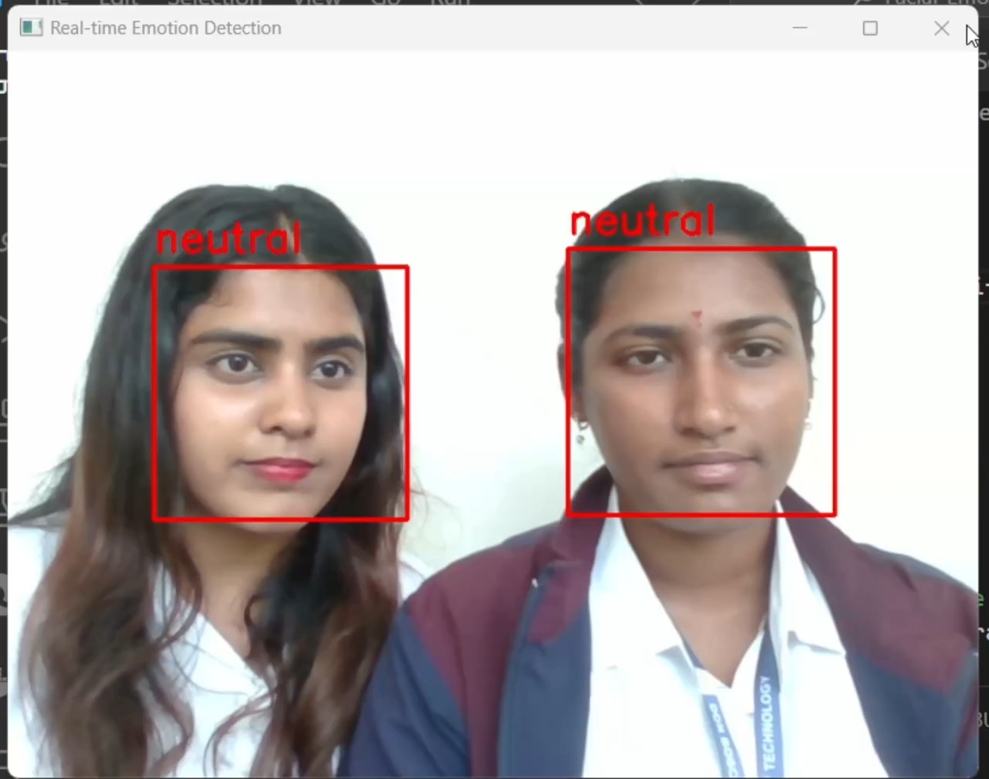

Slide 15
Conclusion
The emotion detection system demonstrated high accuracy, particularly for easily distinguishable emotions like happiness and surprise, while emotions such as fear and disgust were more challenging to classify. Data augmentation significantly improved the model's robustness, enabling effective real-time performance. Misclassifications observed in the confusion matrix indicated areas for further refinement, particularly in distinguishing subtle and overlapping facial expressions. Future enhancements will focus on expanding the dataset, exploring advanced deep learning architectures, and ensuring ethical considerations are addressed. Overall, the project showed promising results, indicating the feasibility and potential applications of the emotion detection system.

Slide 16
Future Improvements:
Hybrid Models: Combine traditional and deep learning approaches.
Explainable AI: Implement transparent decision-making processes.
Edge Computing: Perform tasks locally for better privacy and speed.
Adaptive Learning: Continuously improve with new data.
Ethical AI Frameworks: Ensure responsible development and use.
Robustness to Attacks: Enhance defenses against adversarial attacks.
User-Friendly Interfaces: Design intuitive and accessible interfaces.

Slide 17
REFERENCES
https://doi.org/10.1016/j.matpr.2021.07.046
https://doi.org/10.1155/2019/9185481
https://doi.org/10.1016/j.anireprosci.2018.01.004
https://youtu.be/G1Uhs6NVi-M?si=rl9BuJDsvIQCzOt0
https://youtu.be/Vq_01gFG2vk?si=rHBurRUz-OU-x-o4
https://youtu.be/Bb4Wvl57LIk?si=O6N5XjQuxgHGRKLj
https://youtu.be/fkgpvkqcoJc?si=wb75MI2o9VW8yPxZ
https://youtu.be/n84hBgtzvxo?si=0Jf5sznItCso7lBG

Slide 18

?
ANY QUESTIONS

Slide 19


